Slide 1


Social Buzz

Slide 2


Today's agenda
Project recap
Problem
The Analytics team
Process
Insights
Summary

Slide 3

Social Buzz is a fast growing social media platform that needs to adapt quickly to it’s global scale. Accenture has begun a 3 months POC focusing on 3 tasks:
An audit of Social Buzz’s big data practice
Recommendations for a successful IPO
Analysis to find Social Buzz’s top 5 most popular categories of Content
Project Recap

Slide 4

Problem
Utilizing the power of data analysis to uncover insights that can help capitalize the millions of posts on the app.

Slide 5



Myself
Data Analyst
The Analytics team
Marcus Rompton
Senior Principle
Andrew Flemming
Senior Technical Architect

Slide 6
Process
1
Data Understanding
2
Data Cleaning
3
Data Modelling
4
Data Analysis
5
Uncover Insights

Slide 7
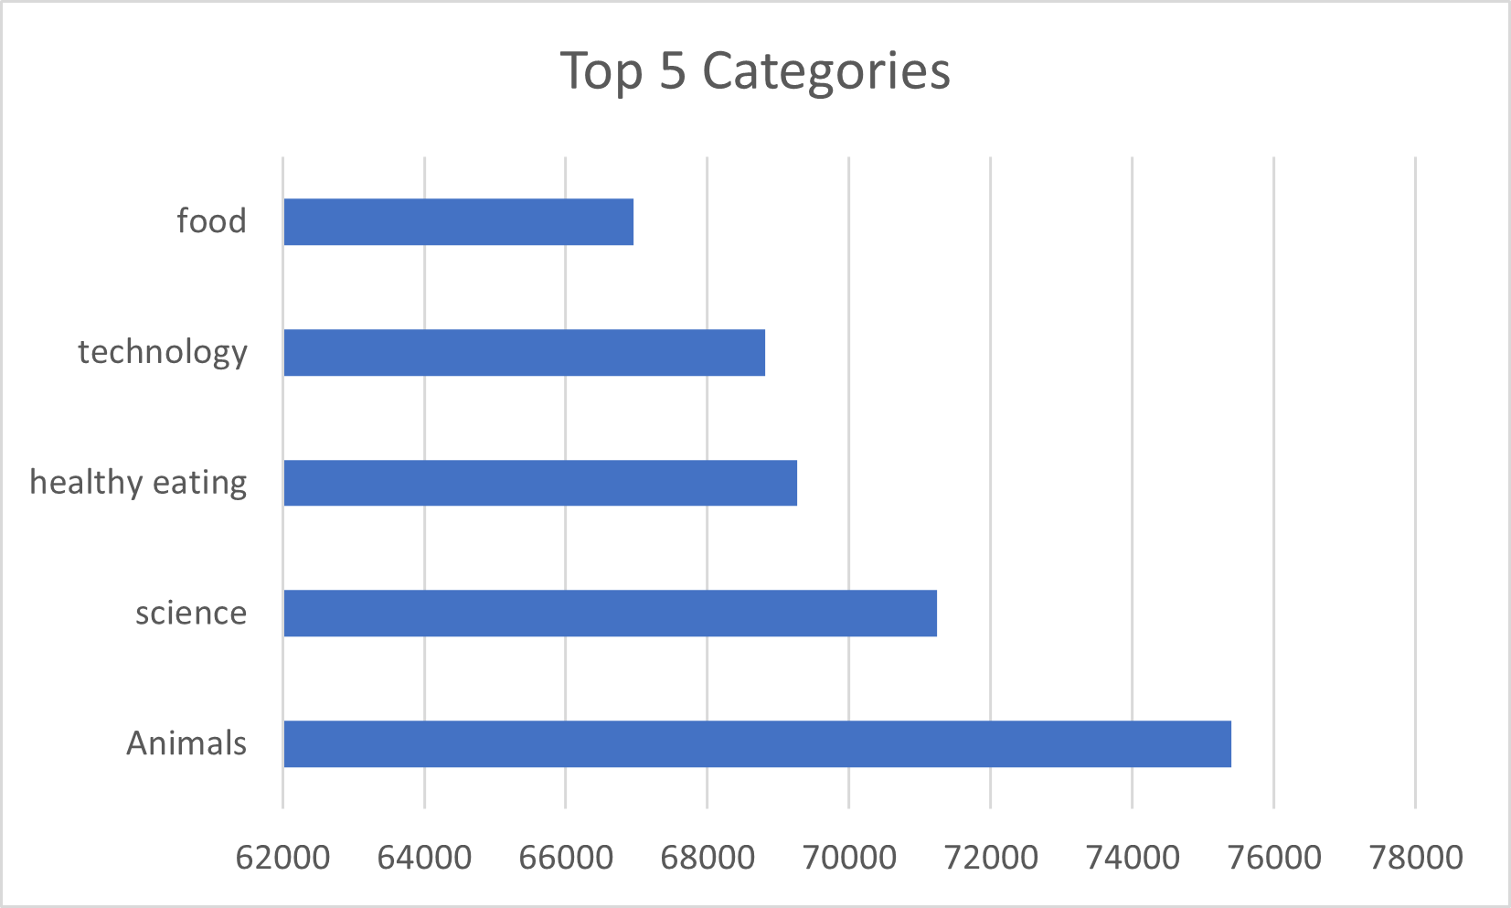

Insights
May, 2021
Month has the most number of posts.

Slide 8
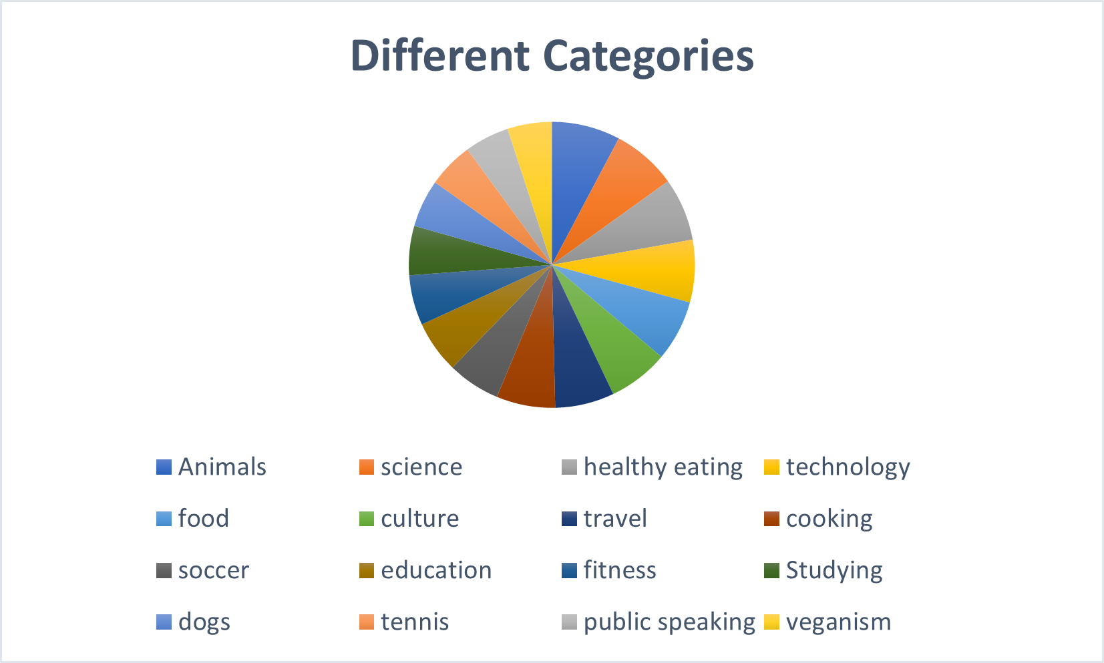

Slide 9
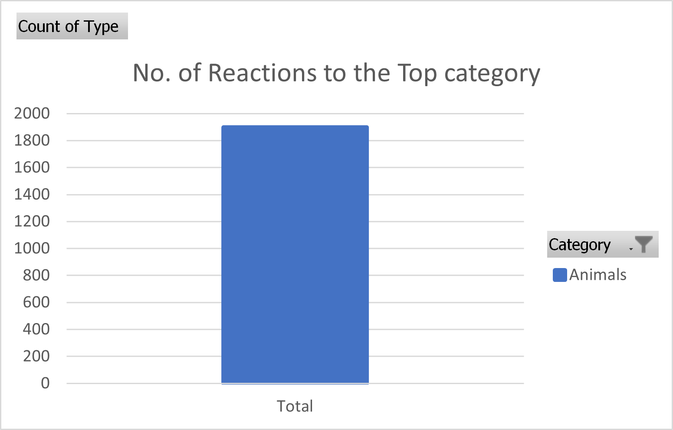

Slide 10

In conclusion,
The top performing categories can be seen in the column chart.
We have further also analyzed the different categories of content present,
the number of reactions to the top performing category of content, and
lastly, the number of posts over time where May of 2021 ended up having the maximum number of posts.
Summary

Slide 11
Thank you!
ANY QUESTIONS?

